Slide 1
Year 1 Phonics Screening Check

Slide 2
What is Phonics?
The children receive a 30 minute Little Wandle phonics session each day.
These sessions are repetitive and build upon prior knowledge.
Children are taught to read by breaking down words to find the diagraph or to use the chunking method.
There are around 40 different sounds.

Slide 3
What is Phonics?
Digraph- 2 letters making one sound cow the children should say this as c-ow and not c-o-w
Trigraphs- 3 letters making one sound night the children should say this as n-igh-t and not n-i-g-h-t which does not sound like night.
Split digraphs- 2 vowels with a consonant in between. Used to be known as the magic e. spine, home, cube.

Slide 4
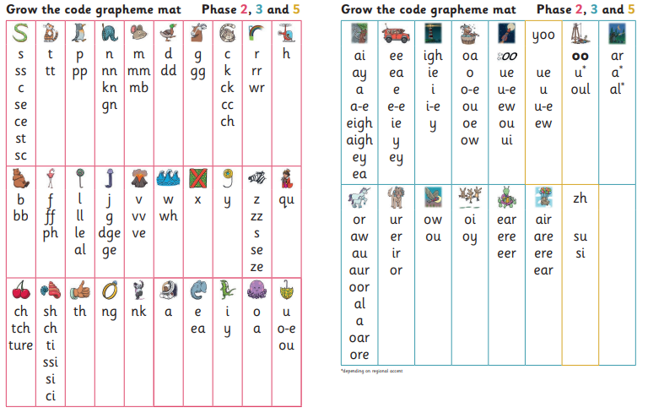
Notes:
Each sound has a picture representative

Slide 5
Why Year One?
Every Year 1 child in the country will be taking the statutory phonics screening check w/c 9th June 2025.
The check is very similar to tasks the children already complete during phonics lessons and it will be done with the phonics teacher.
The focus of the check is to check that children are reading at age related expectations.
The check will ensure children are ready for year 2 and identify any gaps.

Slide 6
What will the children do?
The check will take around 10 minutes to complete
They will be asked to ‘sound out’ a word and blend the sounds together. e.g. d-o-g – dog
The children DO NOT need to be able to blend these words fluently.
The check will consist of 40 words and non-words;
Children will be told if the word is a real or ‘alien’ word, with a corresponding alien image.

Slide 7
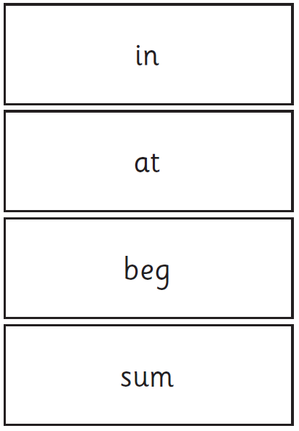
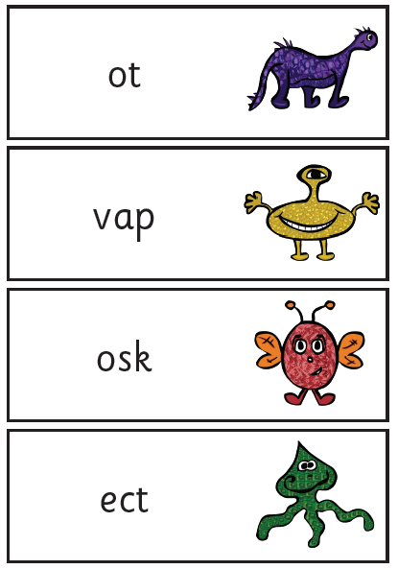
Examples of words – Section One

Slide 8
Examples of words – Section Two

Slide 9
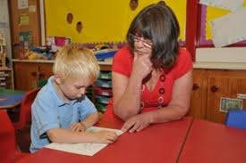
How and When?
The screening will take place during the week commencing 9th June 2024. It is very important your child is in school during this week as if they do not sit the test they will have a score of 0.
Teachers will conduct all of the screening checks with the children. The children will be very familiar with this routine.
The check has been designed so that children of all abilities will be able to take part.
The children will complete the check one to one in a quiet area of the school.
We are not permitted to indicate to the children at the time whether they have read the word correctly.

Slide 10
The Results
The children will be scored against a national standard (determined by DfE) in the past this has been 32 but we will not know this information until after the test.
We will inform you of the results during the summer term with their summer report.
If your child’s score falls below the national standard they will be supported and will complete the screening again in year 2.

Slide 11
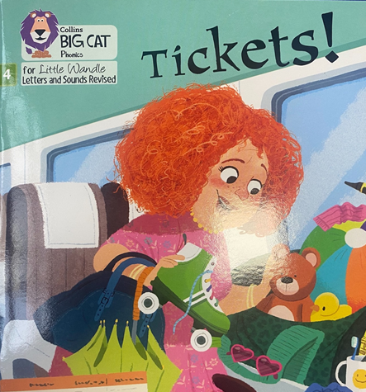
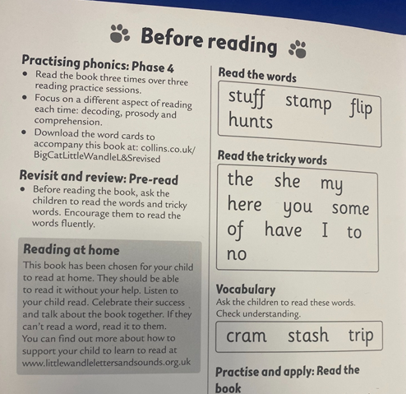
How can you help?
Reading at home and Evidence Me.

Slide 12
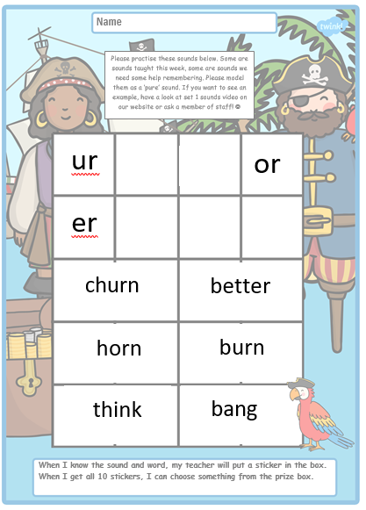
How can you help?

Slide 13
How can you help?

Slide 14
How can you help?

Slide 15
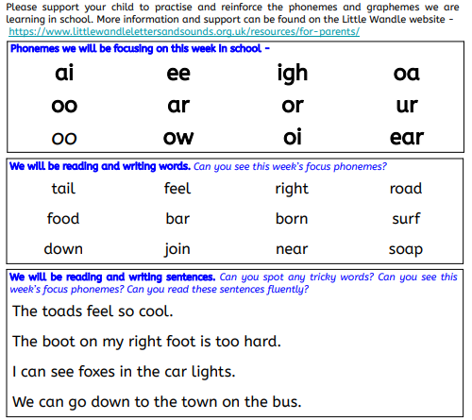
How can you help?
Home Learning Sheet – School Website.

Slide 16
Phonics Websites www.bbc.co.uk/schools/wordsandpictures/phonics/ mix of very good interactive games and worksheets covering most phonic phases. Recommend Sandcastle quiz for phase 3 and 5. www.ictgames.com/literacy.html a great selection of games that link well with games in Letters and Sounds. www.phonicsplay.co.uk a selection of interactive games for all phonic phases – Free resources section. www.free-phonics-worksheets.com worksheets for- - long vowel sounds, - Phase 3 and 5 sounds. www.firstschoolyears.com a good selection of resources including worksheets and some interactive games. Covers- - Phase 3 and 5 sounds - Phase 6 work such as prefixes and suffixes, plurals and tense worksheets. - extensive list of long vowel worksheets and games such as hangman. www.sparklebox.co.uk www.twinkl.co.uk Has a Letters and Sounds section that covers all the phonic phases and the tricky words. Please also see the Phonics section of your class page.

Slide 17
QUESTIONS

