Slide 1
How to access Teams Live Lessons and Resources

Slide 2
School Website
Videos and important links can be found on this page on our school website
http://kingsfield.staffs.sch.uk/lockdown-learning/

Slide 3
Microsoft Office Package
The next slide outlines how students can download the Microsoft Office 365
They can use their school email account to get access to these for free
username@kingsfield.staffs.sch.uk
e.g. rbutler@kingsfield.staffs.sch.uk

Slide 4
Installing Office 365 on your laptop / PC
Log in to your school email Click on AppViewer button (top left)
Then click Office 365
A new window will open
Click “Install Office” and “Office 365 apps”
Then follow the instructions

Slide 5
How to access Emails
https://outlook.office365.com
Above is the link to the school email accounts
Your email address and password should be stuck into your Home-school link book

Slide 6
How to access Teams
The next few slides show students how to access Teams at home via their school email account
https://teams.microsoft.com

Slide 7
Step 1: From your email
Click on the 9 dots to open apps
Click on the Teams app

Slide 8
Step 2: Open Teams
It may ask you if you wish to download Teams to your desktop (this is a good idea as it where all your work/ lessons will be)
You can click “use the web app” if you prefer – it may just look slightly different

Slide 9
Step 3: Sign in
If it asks you to log in, you use your school email address and password.
These should be stuck in your Home-school links book

Slide 10
Step 4: Go to Calendar
Click on the calendar tab on the left hand side

Slide 11
Step 5: Click on the lesson

Slide 12
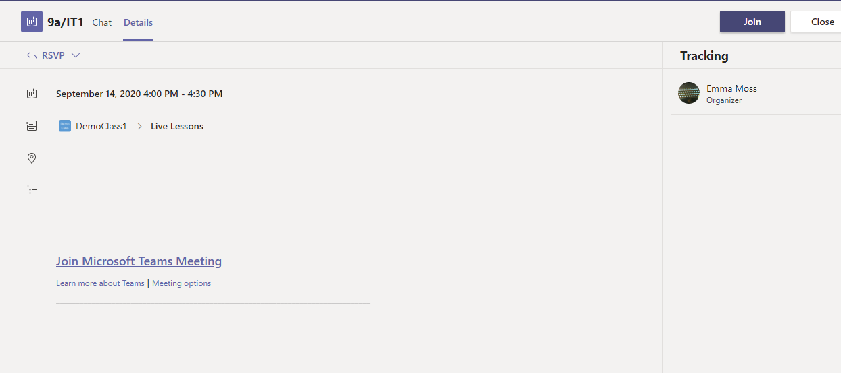
Step 6: Click join
Check the lesson time is correct and click join

Slide 13
Step 7: Microphone off & video on
Ensure your microphone is off but video is on if possible
Then click join

Slide 14
Step 8: Wait for your Teacher
Be patient – we will be with you as quickly as we can
Please right click on the teacher icon to pin the teacher

Slide 15
Step 9: During the lesson
You will need your paper and a pen or pencil
You may be asked to complete assignments or quizzes and send them in
If you are stuck raise your hand

Slide 16
Accessing work at home
All work will be uploaded onto teams
Teachers may post information on the live stream of how to access class materials. Look out for a notification from your teacher.
They will set you either:
An assignment to be completed
Or
2) Share files with you to complete tasks

Slide 17
1) Assignment
Choose your class team
Click on general tab
Click on assignments
Note:
You can click on the assignment tab. This will show you assignments set by ALL your subjects as a list

Slide 18
2) Shared Files
Files can be shared with you
Click the class code
Click general
Click files
Click Class Materials
Here you will also find a recording of your live lessons.

