Slide 1
TTRockstars and Times tables
Monday 13th January

Slide 2
Why?
Times tables are an important concepts as they can help you understand other mathematical concepts. Knowing their times tables can also help your child more readily grasp other important aspects of maths, such as fractions, division and percentages and is an element of learning that assists in life long skills.

Slide 3
Fluency
Children should not only be able to count up and back in their times tables but should be able to recall sums fluently without having to count through their multiples.

Slide 4
How times tables are taught
The National curriculum splits the teaching of times tables within different year groups.
Year 1 – count in 2, 5, 10.
Year 2 – know and recall the 2, 5 and 10 times tables.
Year 3 – know and recall the 3, 4 and 8 times tables.
Year 4 – know and recall all times tables to 12 x 12
With the pressure of the multiplication test in year 4, we at Kingsfield have attempted to push the children by introducing the 3 times table in year 2, introducing the 6 times table in year 3 within the Summer terms to support children in their learning in year 4.

Slide 5
CPA model of times table
Array
Bar Model
Repeated addition
Number line

Slide 6
The multiplication check
The multiplication check gives the children a series of 25 questions all involving their times table (all multiply not divide).
This is an online check and can be completed on an Ipad, computer or laptop.
For each question children will have 6 seconds to read, work out and type their answer before the next question appears.

Slide 7
Example of the test
https://www.timestables.co.uk/multiplication-tables-check/

Slide 8
What are we doing to prepare the children
Children have school and home access to TTRockstars, which helps the children build their speed in answering multiplication questions.
Children complete a times table test every two weeks from year 3 and from the summer term from year 2.
In each class, times table trackers are on display, which allows the children to see which times tables they know and encourages them to learn the next table.
TTRockstars club is starting next week, which is available to year 4’s only, to give access to the app for those children who can’t access it at home and to encourage children to practise their times tables in a fun way.
Interventions – children who are struggling to pick up their times tables will be selected for interventions to help them.

Slide 9
What you can do
Super movers - https://www.bbc.co.uk/teach/supermovers/ks2-maths-the-3-times-table/z6sw382
Games – top marks https://www.topmarks.co.uk/maths-games/7-11-years/times-tables
Use the examples of the multiplication check to get the children used to seeing it in this format and practice what is to come.
Chant the times tables that they know.
Quick fire – how many can you answer in a minute

Slide 10
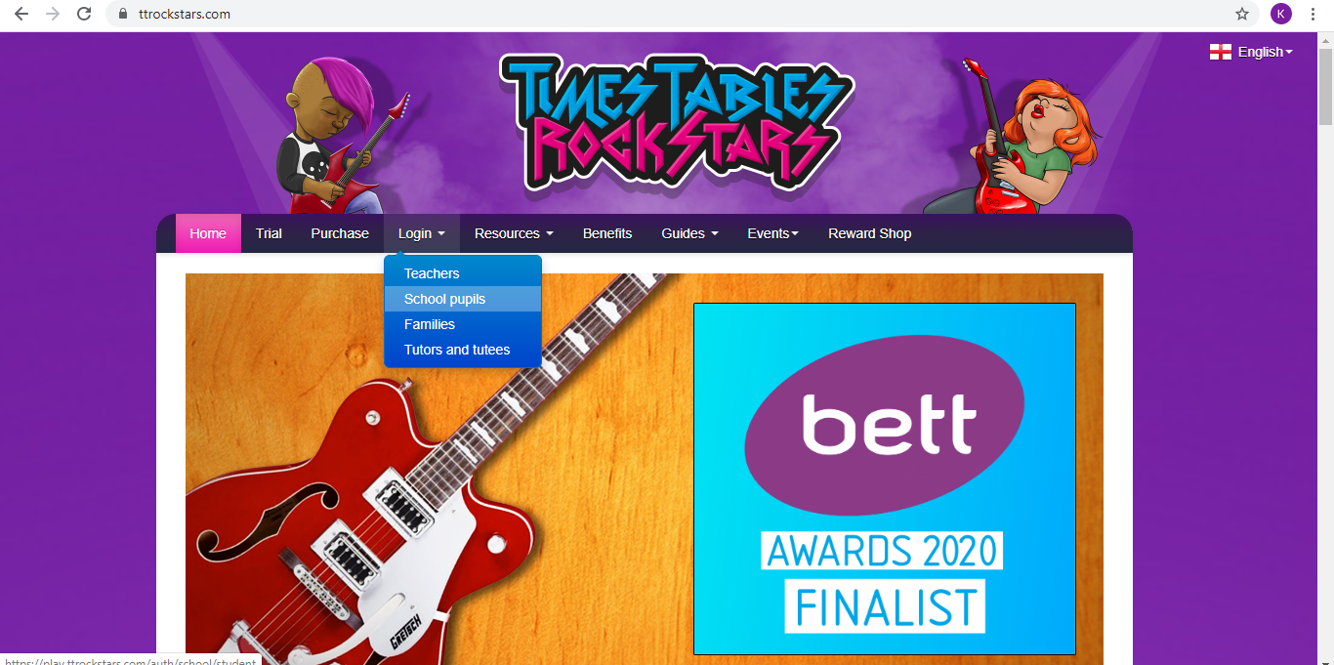
TTRockstars Children’s real name is not used, they are given a name when they first log in.
Login

Slide 11
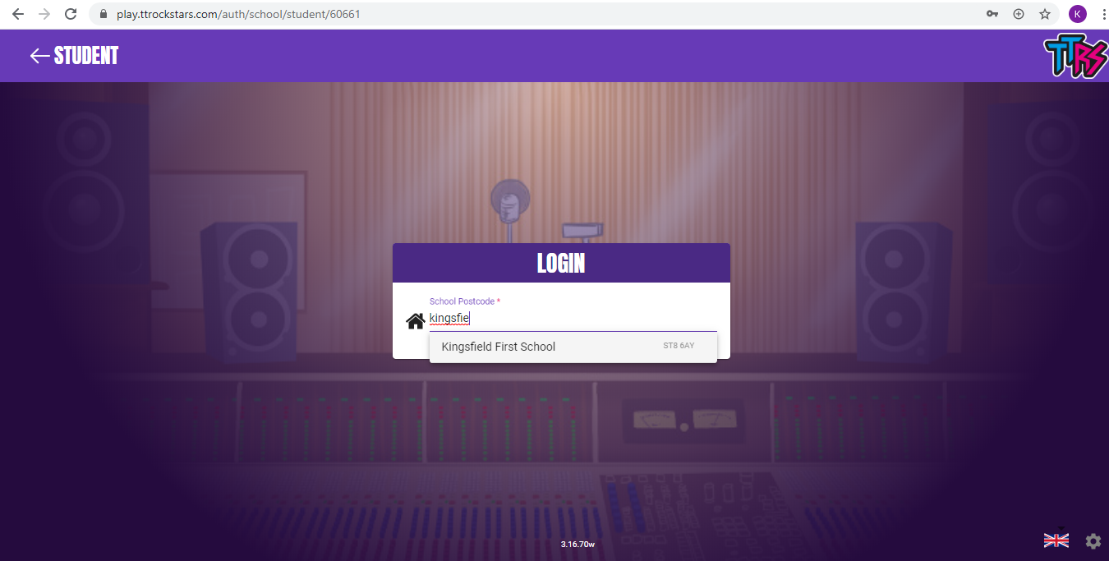

Slide 12
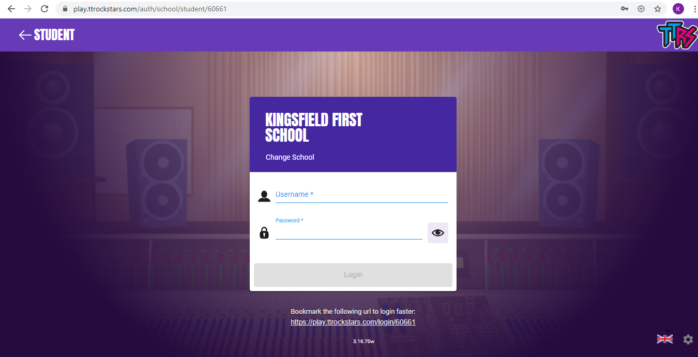
Each child’s login will be at the back of their Home Links Book

Slide 13
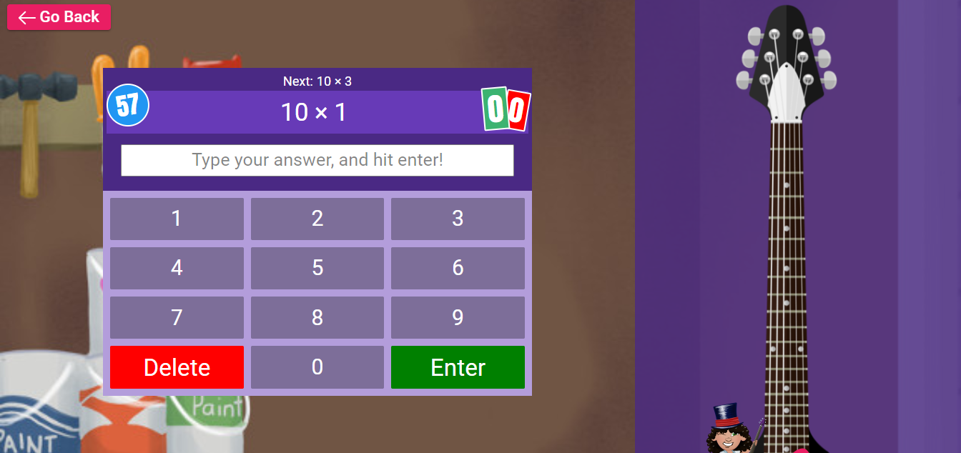
Garage
Children get 1 minute to answer questions on the times tables they are working on – As they get quicker it will begin to give them new times tables

Slide 14
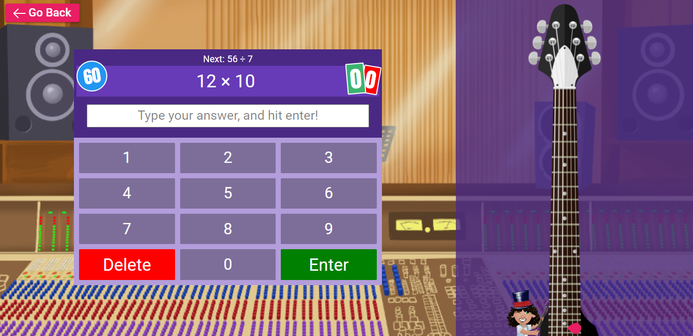
Studio
Children are given 1 minute to answer as many times tables up to their 12 times tables.

Slide 15
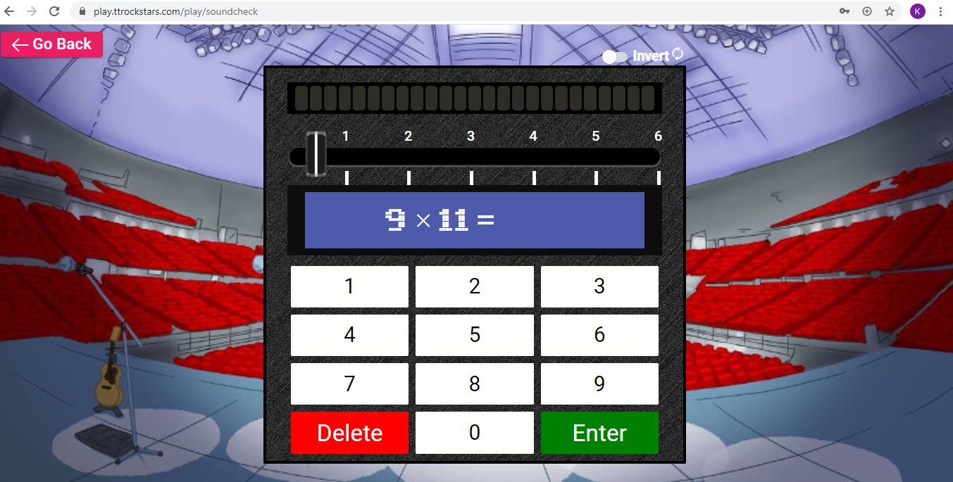
Soundcheck
Children are given 25 questions with 6 seconds to answer (Like the multiplication check) up to their 12 times tables

Slide 16
Multiplayer
Festival
They can play anyone in the world who is playing at the time.
They have 60 seconds to answer as many questions as they can.
Arena
Can battle someone from their class who is playing at the same time.
They have 60 seconds to answer as many questions as they can.
Rockslam
Can battle someone in Kingsfield of their choice including teachers.
They have 60 seconds to answer as many questions as they can.

Slide 17
Any questions

